Slide 1
The ADT Map

Slide 2

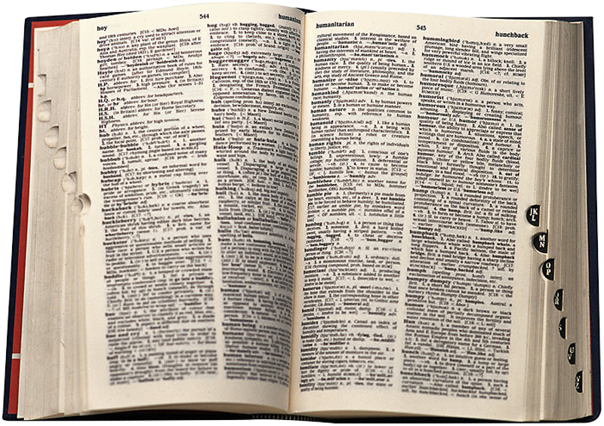

The ADT Map
Map entries contain two parts
Keyword
a search key
Value
associated with key
desired value (or payload)
Notes:
This lecture introduces the concept of the ADT Map.
If you need to check the meaning of a word, you look it up in a Map. If you need a friend’s address, you consult your address book. If you need someone’s telephone number, you check your list of contacts on your cell phone, use a telephone directory, or search for it online. Each of these examples involves a kind of Map. This lecture describes and uses an abstract data type that generalizes our everyday notion of a Map. The previous examples—finding a word’s definition, a friend’s address, or someone’s tele- phone number—are all examples of searching a Map. In a previous lecture, we examined how to search a list. We’ll see that a Map provides a more powerful way to organize data that will be searched.
@@ The ADT Map—also called a map, table, or associative array—contains entries that each have two parts:
@@A keyword—usually called a search key—such as an English word or a person’s name: Some dictionaries have distinct search keys, but others allow two or more entries to have the same search key. For example, a Map of student records organized by student identification numbers has distinct search keys, since those numbers are unique. On the other hand, an English- language Map has duplicate search keys, since it often has several meanings for a word. For example, my Map has three entries for the word “book”: One is a noun, one is a verb, and one is an adjective.
@@A value—such as a definition, an address, or a telephone number—associated with that key
The search key enables you to locate the desired entry.

Slide 3


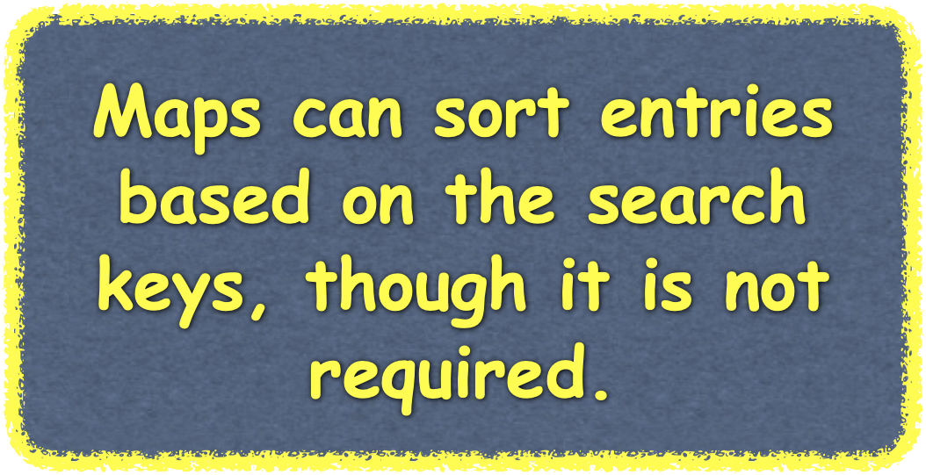
The ADT Map
backtracking | A problem-solving strategy that, when it reaches an impasse, retraces its steps in reverse order before trying a new sequence of steps.
base case | The known case in either a recursive definition or an inductive proof. Also called the basis or degenerate case.
base class | A class from which another class is derived. The derived class inherits the base class’s members. Also called the ancestor class or superclass.
behavior | An action that an object performs.
binary file | A file whose elements are in the computer’s internal representation. A binary file is not organized into lines.
box trace | A systematic way to trace the actions of a recursive function.
circuit | A special cycle that passes through every vertex (or edge) in a graph exactly once.
client | The program, module, or ADT that uses a class.
compiler | A program that translates a program written in a high-level language, such as C++, into machine language.
Notes:
Here is an example of a glossary that could be from our textbook.
@@ Each entry has a word as the search key and the word’s definition as the value associated with the key.
@@ In general, the search keys and values in an ADT Map are objects. Each search key is paired with a corresponding value.
The ADT Map organizes and identifies its entries by their search keys, rather than by another criterion such as position. Thus, you can retrieve or remove an entry from a Map given only the entry’s search key. The fact that every entry in a Map has a search key distinguishes the Map from other ADTs such as a list. Although you certainly could put an entry that has a search key in a list, a list’s data is organized by position, not by search key.
@@ Printed versions of a natural-language Map, a telephone directory, a library catalog, and a thesaurus all have entries sorted by their search keys. These databases are dictionaries, but the ADT Map does not require sorted entries.
Why do our examples of printed dictionaries sort their entries? This makes it easier for the reader to find a particular entry. In contrast, if you searched a computerized thesaurus for a word, you would not be aware of the order of its entries. Nor would you care, as long as you could retrieve a particular entry. Thus, whether a Map has sorted or unsorted search keys is more of an implementation detail than a necessary characteristic of the Map. But remember that the details of any implementation affect the efficiencies of the ADT operations in various ways.

Slide 4

The ADT Map
Map operations are same as other ADTs and databases
add, remove, retrieve, search and traverse
but specified differently -
items are identified by search keys, not positions
Design Decision
Distinct Search Keys
add could fail with duplicate key or replace current value with new value at the key
other methods are simpler
Duplicate Search Keys
add always adds the key, value pair
remove and getValue must decide which of the duplicates to remove or retrieve
Notes:
The ADT Map has the same major operations—insert, delete, retrieve, search, and traverse— that are common to most databases, even if a particular implementation sorts its entries or allows duplicate search keys. Because we are finding items based on search keys an important design decision we must make is
@@ whether or not to permit duplicate search keys in our Map.
If we decide on Distinct search keys, The method add can ensure that the search keys in a Map are distinct. If key is already in the Map, the operation add(key, value) could either refuse to add another key-value entry or change the existing value associated with key to the new value. In this second case, the method could return the old replaced value instead of not having an output, as indicated earlier.
Regardless of how add guarantees distinct search keys, the remaining methods can have simpler implementations than if duplicate search keys are allowed. For example, the methods remove and getValue will either find the one value associated with a given search key or discover that no such entry exists.
@@ If we permit Duplicate search keys - the method add will adds every given key-value entry to a Map, the methods remove and getValue must deal with multiple entries that have the same search key.
Which entry should be removed or returned? The method remove could either remove the first value it finds or remove all values associated with the given search key.
If getValue returns an object, it could return the first value it finds. Or you could modify getValue to return a list of values, for example.
For simplicity, we our examples will assume distinct search keys so now Let’s look at the specifications for our Map with distinct keys.

Slide 5
The ADT Map
Abstract Base Class MapInterface
Assume that all items in the Map have distinct search keys.
Options for Add Functionality:
Add operation can deny an attempt to insert a new entry whose search key already exists in the Map
Add can replace an existing entry whose search key matches the search key of a new entry with the new entry
template<class ItemType, class KeyType>
class MapInterface
{
public:
virtual bool add(const KeyType& searchKey,
const ItemType& newItem) = 0;
virtual bool remove(const KeyType& searchKey) = 0;
virtual bool isEmpty() const = 0;
virtual int getNumberOfItems() const = 0;
virtual void clear() = 0;
virtual ItemType getItem(const KeyType& searchKey) const = 0;
virtual bool contains(const KeyType& searchKey) const = 0;
virtual void traverse(void visit(ItemType&)) const = 0;
virtual ~MapInterface() { }
}; // end MapInterface

Slide 6
Map Implementations

Slide 7




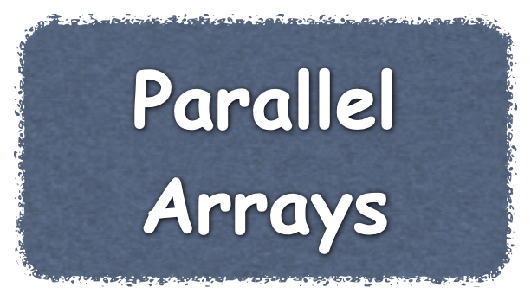

An Array-Based Map
José Gomez
555-1234
John Jones
555-1111
Jill Smith
555-9999
keys
0 | 1 | 2 | 3 | 4 | 5 | 6 | 7
Array Index
Map Keys
José Gomez
John Jones
Jill Smith
555-1234
555-1111
555-9999
numberOfEntries
values
Map Values
3
0 | 1 | 2 | 3 | 4 | 5 | 6 | 7
Array Index

Slide 8

An Array-Based Map
Jill Smith
555-9999
José Gomez
555-1234
John Jones
555-1111
John Jones
555-1111
Jill Smith
555-9999
key
value
José Gomez
555-1234
key
value
key
value
numberOfEntries
Map
Map Entries
3
0 | 1 | 2 | 3 | 4 | 5 | 6 | 7
Array Index

Slide 9
An Array-Based Map
Ensure capacity in array
Insert newest entry
Marcus Marceau
555-3333
oldMap
José Gomez
John Jones
Sam Public
Jill Smith
Taka Tamura
Map
555-1234
555-1111
555-2222
555-9999
555-4444
Notes:
here we have our entries
@@ and the array that holds them
@@ we are asked to add and entry for Mark Martin to the Map
@@ we first ensure capacity by creating a reference to the current Map
@@ and then creating a new double-size array for our Map
@@ and copying the current references to that array
@@ we then need to make room for the new entry by shift the contents of subsequent array locations toward the end of the array
@@ starting with the last entry
@@ we can then add the entry to the Map
Notice that we copied these references twice - for a small array such as this, that is not a lot of extra work. But for an array of thousands of items, we want to reduce the amount of “double-copying” that occurs.
Can we do that here? And still have a method flexible enough to not increase capacity when not necessary? We we can, so let’s see how our new “makeRoomAndCapacity” method works

Slide 10
An Array-Based Map
Ensure capacity and insert entry
Marcus Marceau
555-3333
oldMap
José Gomez
John Jones
Sam Public
Jill Smith
Taka Tamura
Map
555-1234
555-1111
555-2222
555-9999
555-4444
Notes:
Let’s begin with our Map filled to capacity and our request to add the entry for Mark Martin.
@@ in this example, we need to both increase the Map size and make room for the entry, so we begin the same way we did in our old ensureCapacity method and create a reference to the old Map and new double-size array
@@ Now, when we copy the references, we only copy up to the point where our new entry will be inserted.
@@ Entries after the location where we insert our new entry are shift to the subsequent array location when when we copy the reference, thereby saving us recopying.
@@ We can then add our new entry at the appropriate location.

Slide 11


A Sorted Linked Map
Jill Smith
555-9999
José Gomez
555-1234
John Jones
555-1111
John Jones
555-1111
/
Jill Smith
555-9999
key
value
next
José Gomez
555-1234
key
value
next
head
key
value
next
numberOfEntries
3

